Slide 1
Data Visualization Principles
Shannon Haymond

Slide 2
Lesson Goals
Identify types of common data visualizations that are most appropriate given the types of data available and the goal of the analysis
Lesson Objectives
Describe at least 2 scenarios in which a plot is more effective than a table in demonstrating relationships between variables in a data set
For each possible combination of data types, identify a type of plot that will effectively illustrate the relationship between two variables
List 2 types of plots that can illustrate statistical uncertainty when comparing numeric values between groups.

Slide 3
Purpose of Visualizations
Communicate — tell a clear story that can be more inclusive
Discover — fast exploration of assumptions, surface patterns, outliers, and data-quality issues
Compare & Relate — show differences, trends over time, and relationships between variables
If done well, visualization can build trust and drive action
Notes:
Shannon
Focus here is on communication and more specifically of quantitative information – is this true?? Case 2 Is more analysis focused, right?
— provide transparency and understanding for monitoring, interventions, and outcomes

Slide 4

But when done wrong, can be harmful
Common mistakes:
Data misrepresentation or quality issues
Misusing and overcomplicating charts
Misleading color, elements, axes, and scales
Bad outcomes:
False conclusions lead to bad decisions
Reduced clarity erodes understanding and raises skepticism

Slide 5
Data visualization best practices
Match visual to purpose & data type
01
Make comparisons effortless
02
Use effective visual encodings
03
Design for readability & accessibility
04

Slide 6
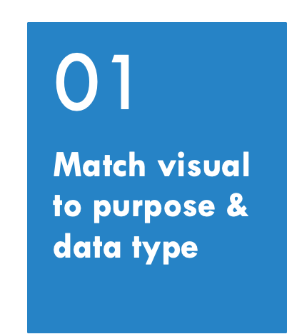
What is the purpose of the visualization?
High level exploration and discovery
Deeper level of comparison and understanding relationships
What type(s) of data will be visualized?
Quantitative vs qualitative

Slide 7
Discover: Exploratory Data analysis
Goal is to show shape and distribution of data with obvious patterns and data quality issues
Insight into spread of data, outliers, general shape and distribution
Investigate single columns of data, maybe some basic relationships
Do your assumptions hold? Are there data quality issues?

Slide 8

What types of visualizations show data distributions?
Poll

Slide 9
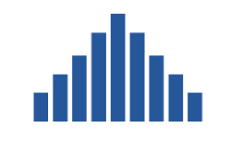
Histograms provide insight into distribution
Type of bar chart used to visualize distribution of quantitative data
Typically focuses on a single variable
Requirement: define bins for x-axis
Y-axis represents the count or frequency within the bin

Slide 10
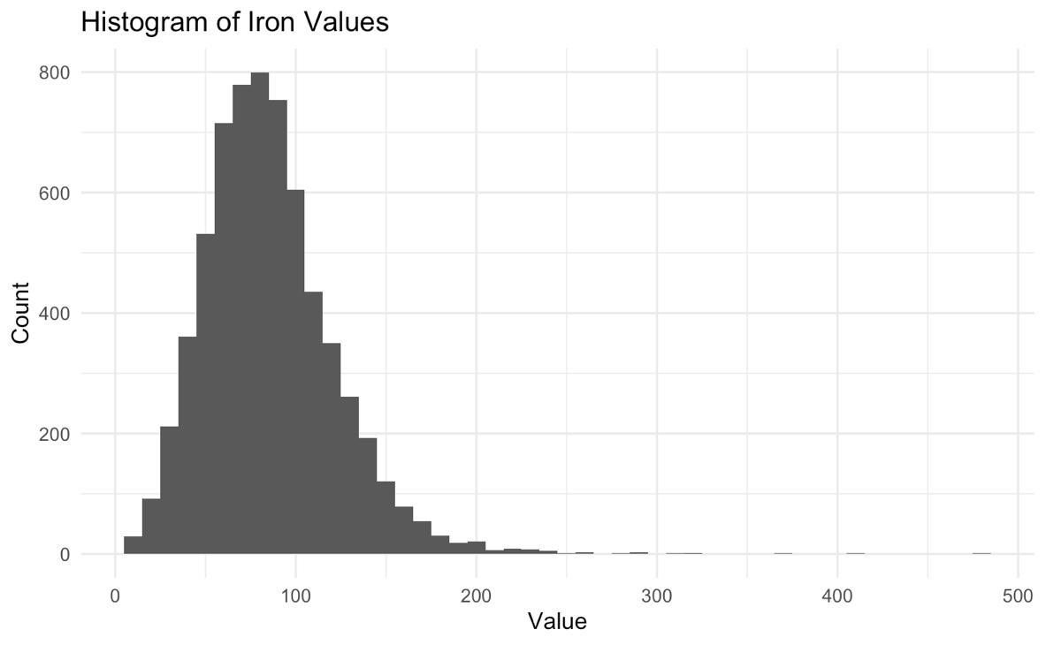
Example: histogram of iron values
Positive kurtosis
Bins 10 mcg/dL wide
Number of observations
Positive skew
Numeric variable of interest
Notes:
Dimension:
Skewness describes a distribution's horizontal spread and balance, while kurtosis describes its vertical spread and the presence of outliers.
Symmetry vs. Tails:
Skewness tells you about the symmetry around the mean, while kurtosis tells you about the concentration of data in the tails.
Comparison to Normal Distribution:
A distribution close to normal has skewness near 0 and an excess kurtosis near 0.
Leptokurtic (positive excess kurtosis): A higher, sharper peak and fatter tails than a normal distribution, indicating a higher concentration of data around the mean and more extreme values

Slide 11
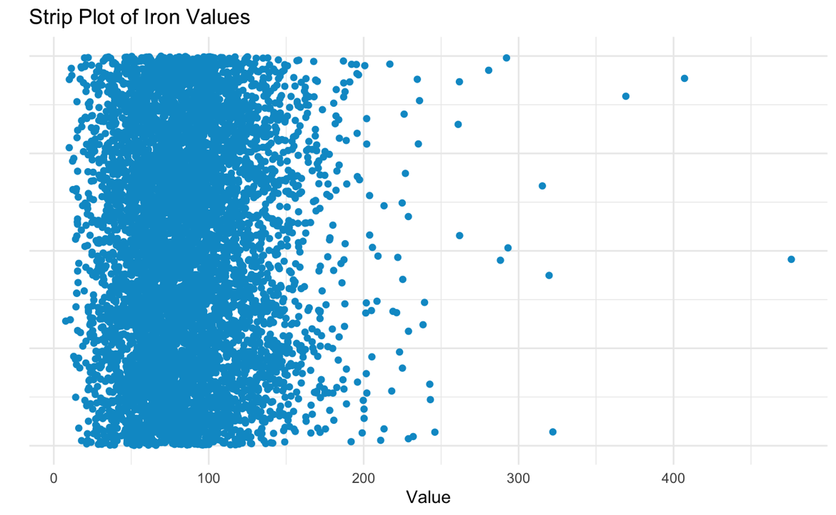
Strip plots show every point in a distribution
High density may obscure number of observations
Single observation
Numeric variable of interest

Slide 12
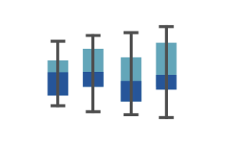
Boxplots also a way to visualize distributions
Subset a continuous (numeric) variable by a qualitative variable
Incorporates a statistical summary of data, though distribution may be “abstracted” by box plot
Useful for comparing across groups

Slide 13
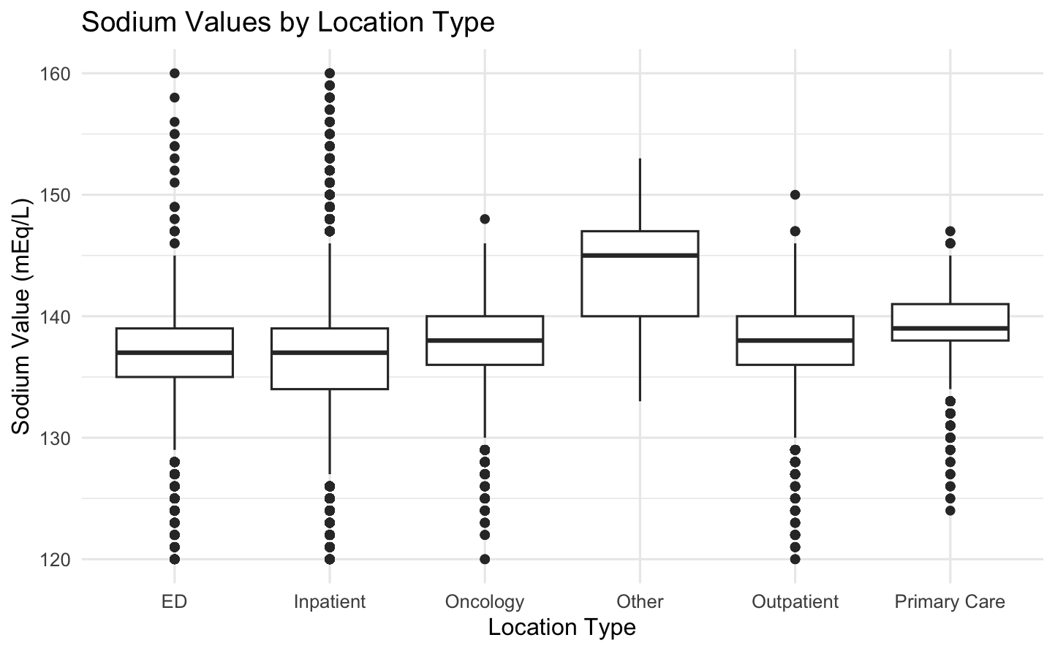
Example: sodium values by location
Outlier
Whisker length of 1.5 IQR (default)
(25% of data points above this value)
Third quartile
Numeric variable of interest
Interquartile range (IQR)
Median
First quartile
(25% of data points below this value)
Qualitative variable

Slide 14
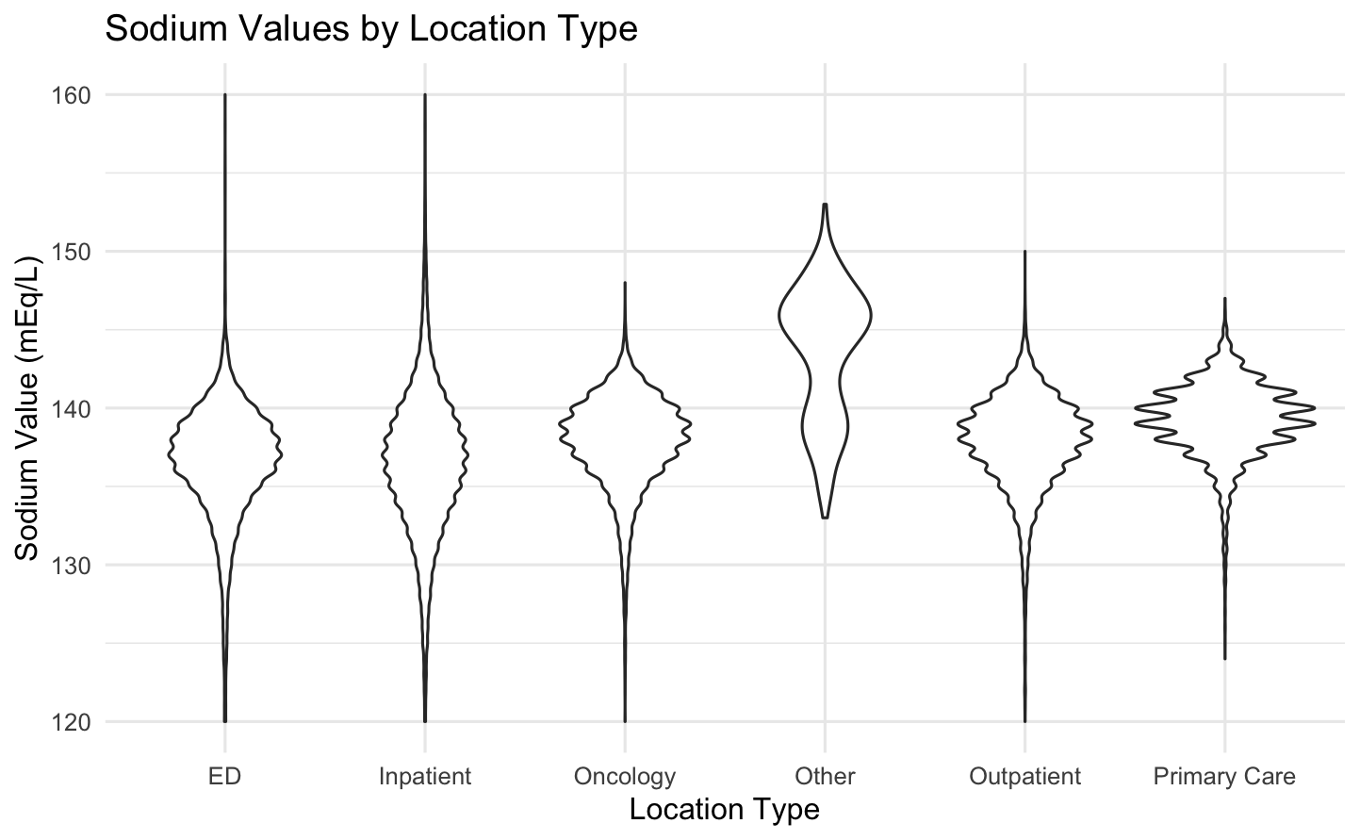
Violin plots better represent the underlying density distribution

Slide 15
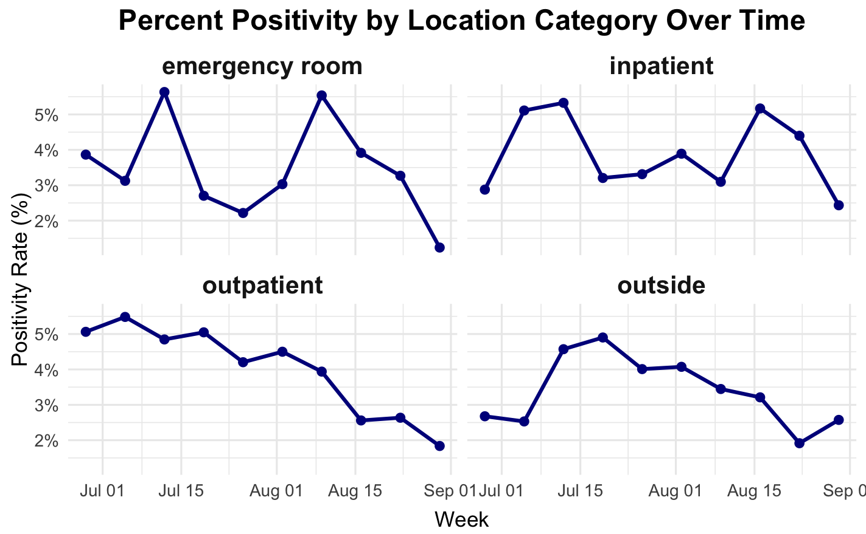
A small multiple can be invaluable in exploratory data analysis
Notes:
Series of graphs or charts using the same scale and axes to support easy comparison

Slide 16
Compare & relate
Goal is to show differences, trends over time, relationships between variables, and uncertainty, identify patterns
Consider different data types and their relationships
Choose visualization that most effectively displays the desired comparison or pattern
Notes:
Comparing data and examining relationships

Slide 17


consider types of data
Quantitative (numeric)
Qualitative (categorical)
- Ordered vs not
Notes:
Date time are special types of numeric? Or their own? See Patrick’s slides

Slide 18
quantitative relationships
Exercise
Create 2 graphs from available data sets using any tool you prefer
1. Quantitative values and qualitative items
2. Multiple quantitative values
Available data sets:
batch_data.csv
batch_data_wide.csv
chem_data.csv
chem_data_wide.csv
lab_exp.csv
Notes:
What’s an example of each? How might you represent that?

Slide 19
Time’s up!!

Slide 20
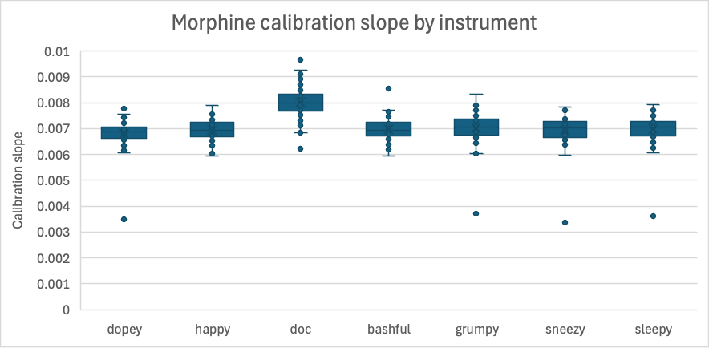
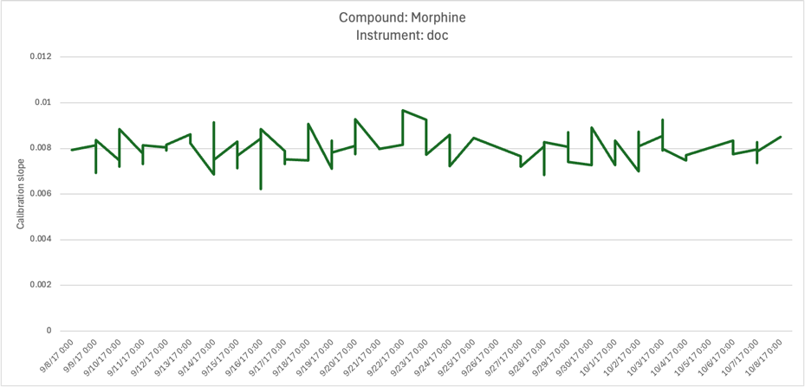
Quant values and Qual items
Exercise

Slide 21
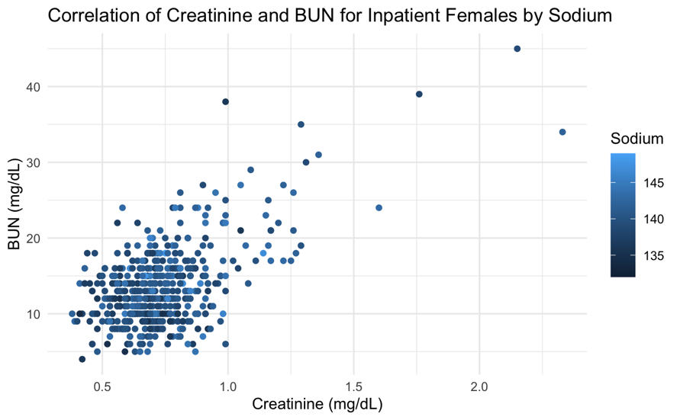
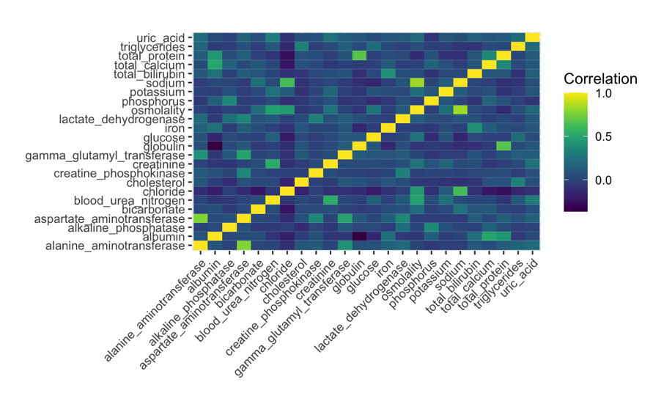
Multiple quant values
Exercise

Slide 22
Types of Comparisons
Change over time (trends)
Point/line/run chart, ribbons for CIs, bar plot, table
Use when: tracking levels, seasonality, shifts, interventions
Ranked or ordered values
Bar plot, lollipop/dot plots, Pareto charts, table
Use when: highlighting “top/bottom” contributors and order
Comparisons across categories
Dot-whisker, box/violin + jitter, bar with CIs, bar plot, table
Use when: displaying differences by groups
Proportions and rates (part-to-whole or success/failure)
100% stacked bars, bar plot, pie chart, donut chart, table
Use when: evaluating contributions of each part or progress to goal
Paired/pre–post or matched observations
Slope or paired estimation plot, dumbbell plot, spaghetti plot, table
Use when: showing individual changes and the overall effect

Slide 23
Types of Relationships
Correlation or deviation between two quantitative variables
Scatter (with fit), difference plot
Use when: assessing correlation, fit function, or bias
Spatial relationships
Choropleth, symbol/heat maps
Use when: values are tied to locations or regions
Multivariate patterns
Heatmaps, correlation matrices, small multiples
Use when: scanning many variables or facets at once
Hierarchies / taxonomies
Dendrogram/tree graph, radial charts, treemaps
Use when: representing qualitative-qualitative associations

Slide 24
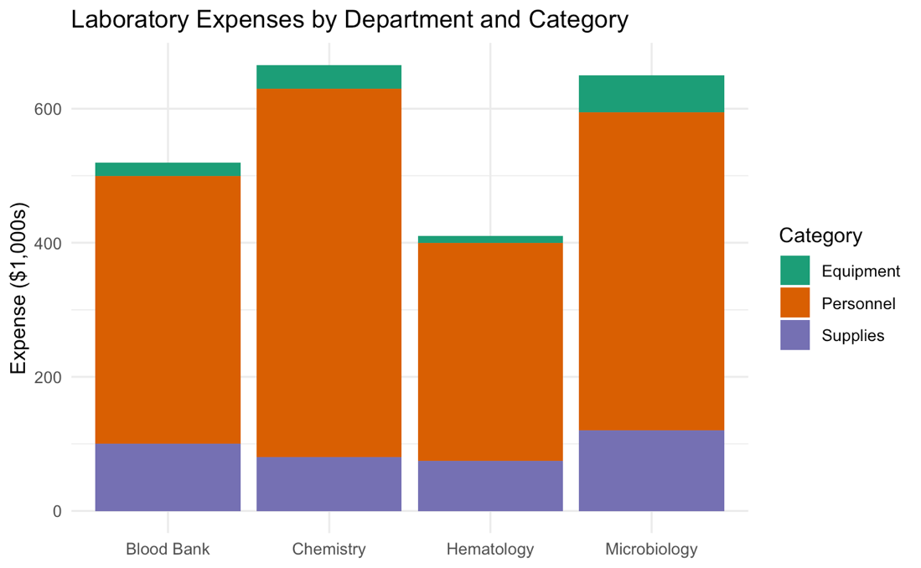
Which is better: Table vs plot?
Poll
Which lab spends least on supplies?
How much more does Micro spend on equipment than Blood Bank?
Notes:
Notice that a table was an option in all of the examples on the previous slide. One of the first questions to consider in data visualization is should you use a table to display data

Slide 25
Time’s up!!

Slide 26
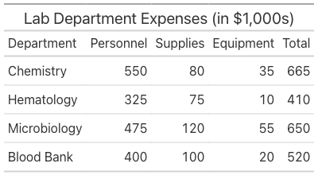
Which is better: Table vs plot?
Poll
Which lab spends least on supplies?
How much more does Micro spend on equipment than Blood Bank?
Notes:
Notice that a table was an option in all of the examples on the previous slide. One of the first questions to consider in data visualization is should you use a table to display data

Slide 27
Time’s up!!

Slide 28

Which is better?
Notes:
How many people got the same answers from both plot and table? Did you get answers from the plot vs the table?

Slide 29
When to display data in a table?
If one or more of the following are true, use a table:
Users will look up one or more individual values
Purpose is for one-to-one comparisons vs focused on finding patterns in data
Precise values are required (i.e., show multiple decimal places)
The display includes quantitative values with more than one unit of measure
Users require summary and detailed values in the same display
The dataset being displayed is sparse (e.g., 5-10 values)

Slide 30
When to Choose a Plot?
Visualizing trends, relationships, distributions, uncertainty, and patterns in data sets
Particularly when working with 2 or more variables
Conveying a high-level overview of data for quick insights
Visualizing large datasets

Slide 31
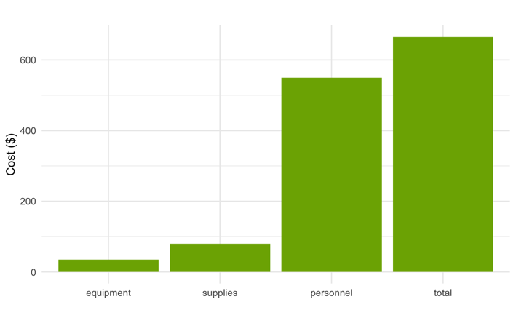
Bar plots Compare values across categories
Bar represents quantity or statistic for a categorical variable
Broadly applicable for visualizing individual values and for making comparisons by groups
Many variations available
Not best choice for continuous data

Slide 32

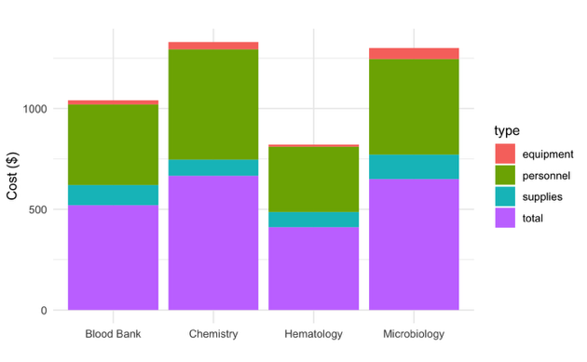
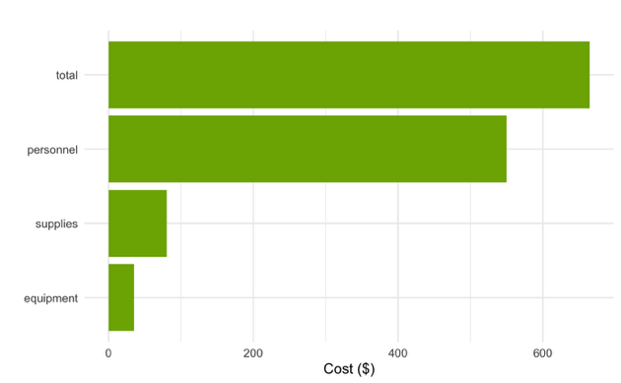
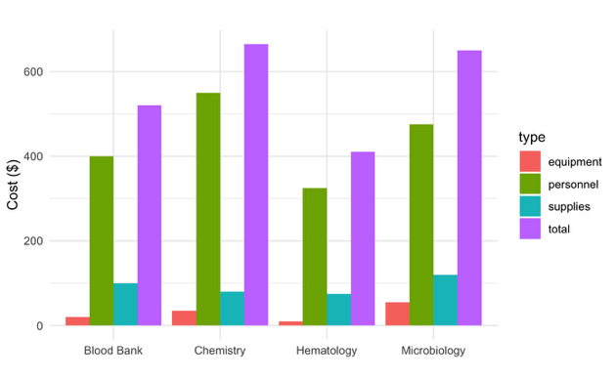
Examples: Lab costs by category
Categorical variable of interest 2
Numeric variable of interest
Categorical variable of interest
Notes:
may show stat (count) or actual value

Slide 33
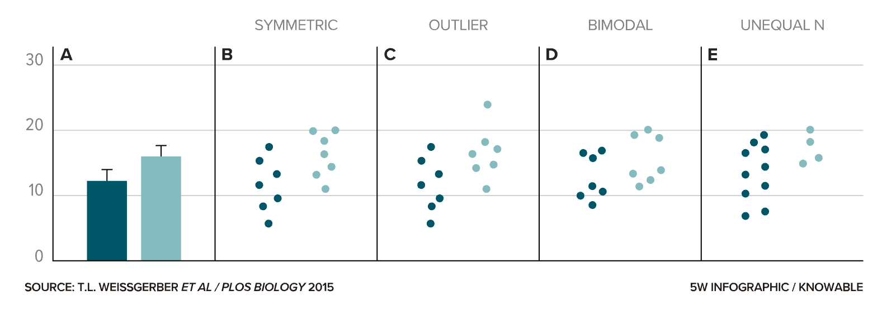
Caution when using Bar plots for continuous data -- may mask important aspects
https://knowablemagazine.org/content/article/mind/2019/science-data-visualization

Slide 34
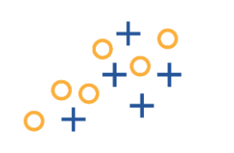
Scatterplots show relationships between quantitative variables
2 separate variables represented on x- and y-axes
Each dot represents a single data point or transaction
Lab context: each dot is a single sample with two variables (e.g. methods)

Slide 35
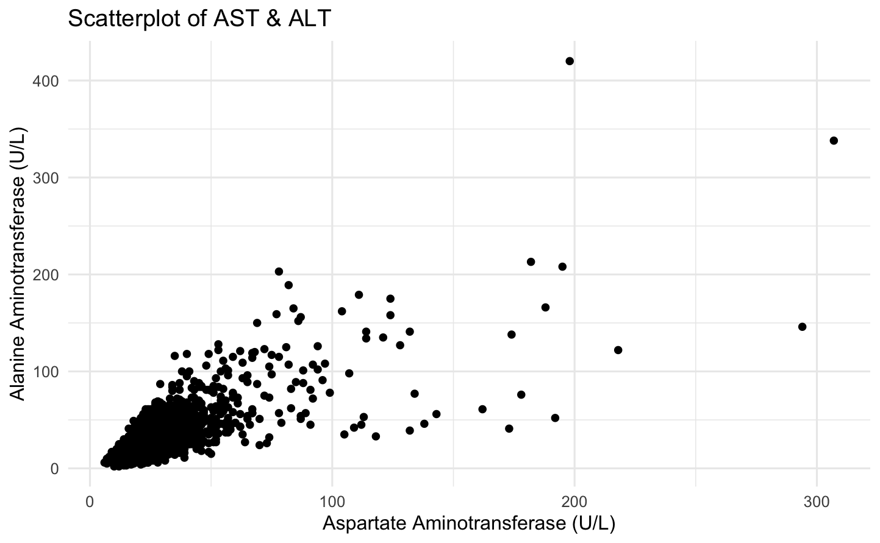
Example: correlation between liver enzymes
High density may obscure number of observations
Single observation
Numeric variable of interest 2
Numeric variable of interest 1

Slide 36
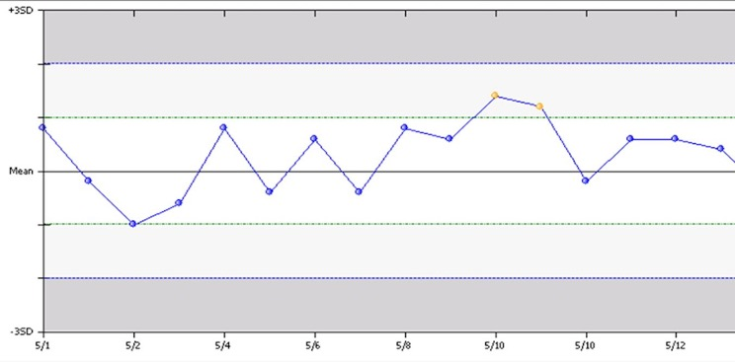

Line charts help visualize trends over time
Another representation of 2 separate variables, with one being ordered
Ordered variable most commonly = time
Data points connected to help visualize change across the ordered variable
Levey-Jennings Chart

Slide 37
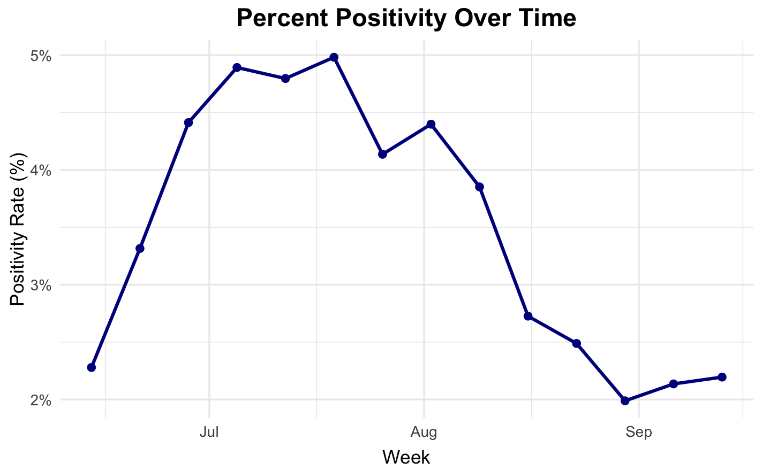
Example: SARS-CoV 2 positivity rates over time
Single observation
Numeric variable of interest
Time variable
Notes:
Call out that line shows progression

Slide 38
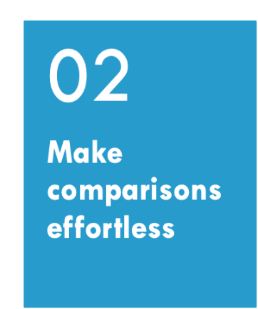
What is the key message for the audience?
Focus the content for this purpose
How can you make it more obvious?
Refine graphic and display elements
01

Slide 39
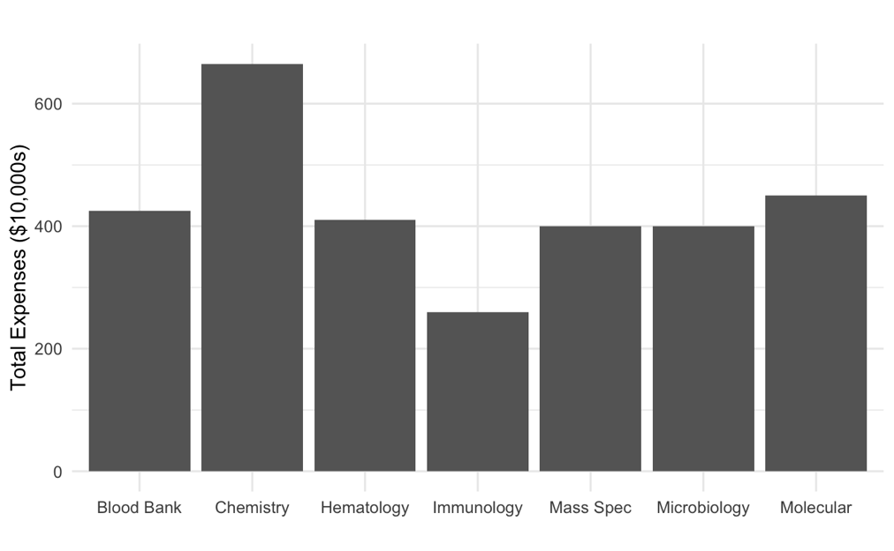
How to make comparisons effortless?
Poll
Which labs have the highest and lowest expenses?
What can we change to make comparisons easier for this bar plot?
Notes:
Make comparisons effortless Sort categories, align/standardize axes across panels, use small multiples, and direct labels instead of hard-to-scan legends. Always show denominators. Ex: 100% stacked bars of positivity by service, sorted high→low with percent labels.
Answers: sort or add color, add labels directly, rotate

Slide 40
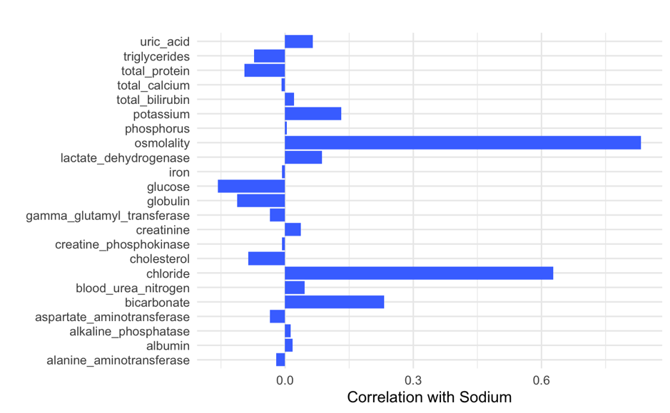
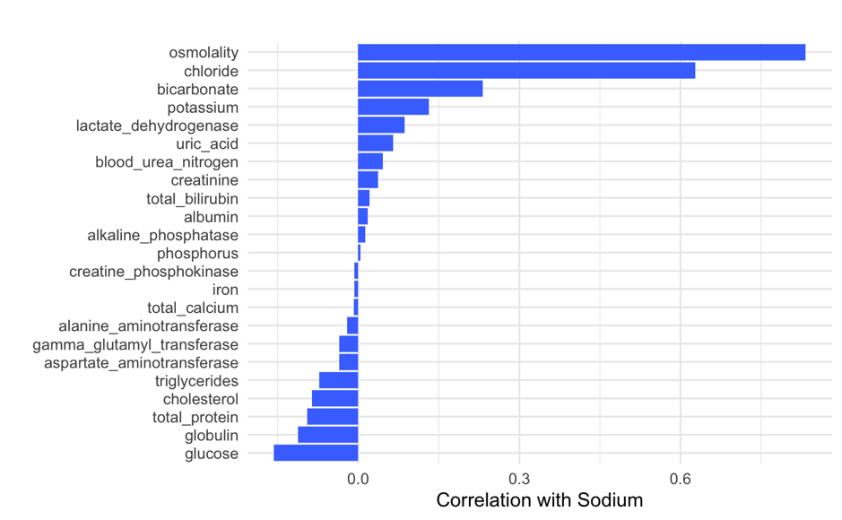
Sorting categories by the metric is better
Notes:
How many people got the same answers from both plot and table? Did you get answers from the plot vs the table?

Slide 41

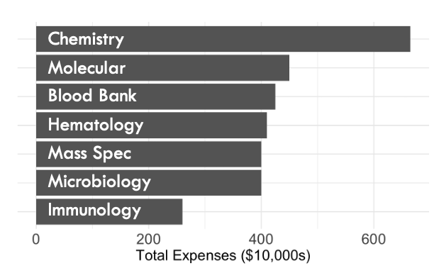
Which is better?
Poll
Notes:
How many people got the same answers from both plot and table? Did you get answers from the plot vs the table?

Slide 42
Use LAYOUt & scales effectively
Sort categories by the metric (e.g., high→low) and keep the same order across panels
Use consistent axes across small multiples; align zero baselines
Keep aspect ratios that don’t exaggerate slopes; avoid dual y-axes and 3D

Slide 43
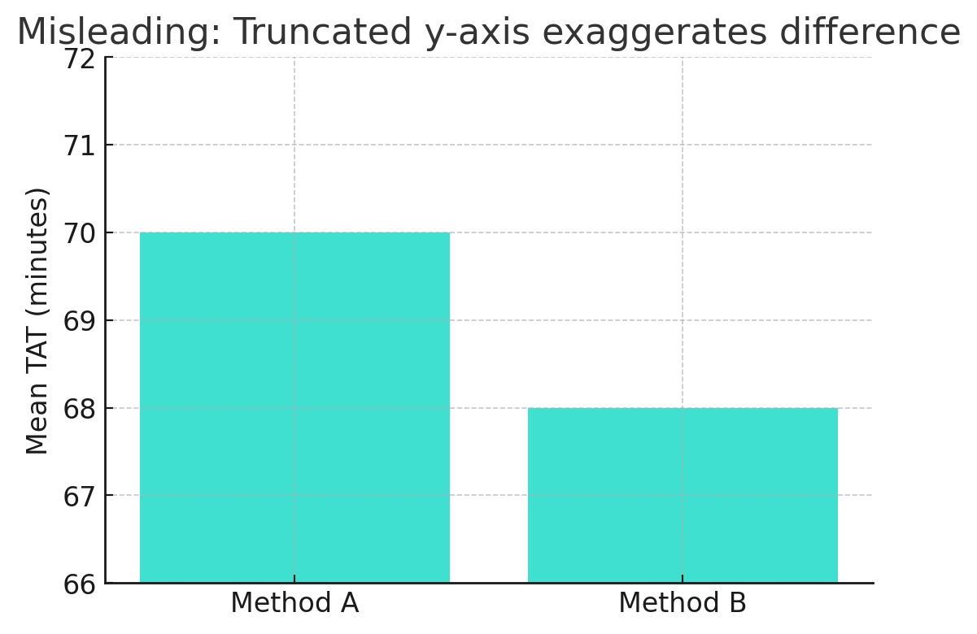
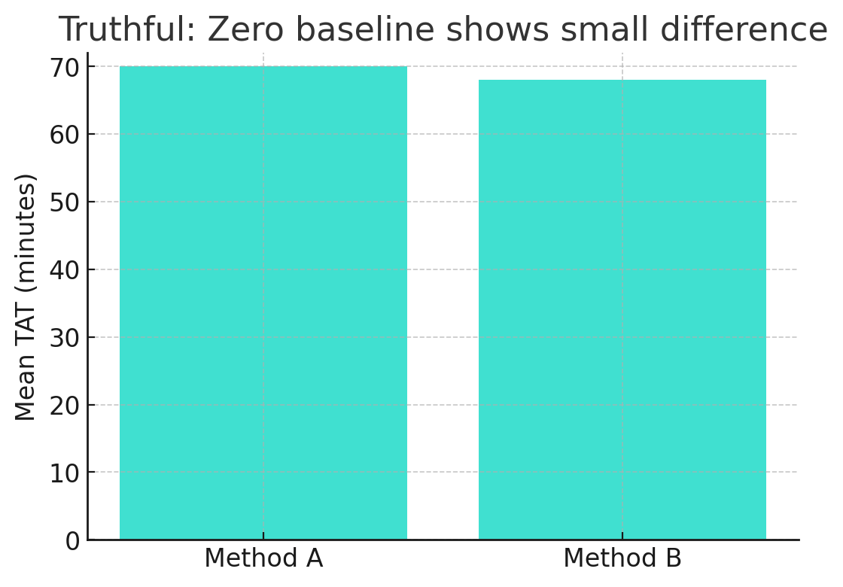
Truncated SCALES can be misleading
Better: Truncated axis but direct label avoids wrong conclusion
The mean TAT difference is 2 min
Notes:
Start bar charts at zero, avoid dual y-axes and 3D, choose sensible binning/smoothing, and keep aspect ratios that don’t distort trends. Ex: QC run charts with consistent y-limits across instruments/lots.

Slide 44
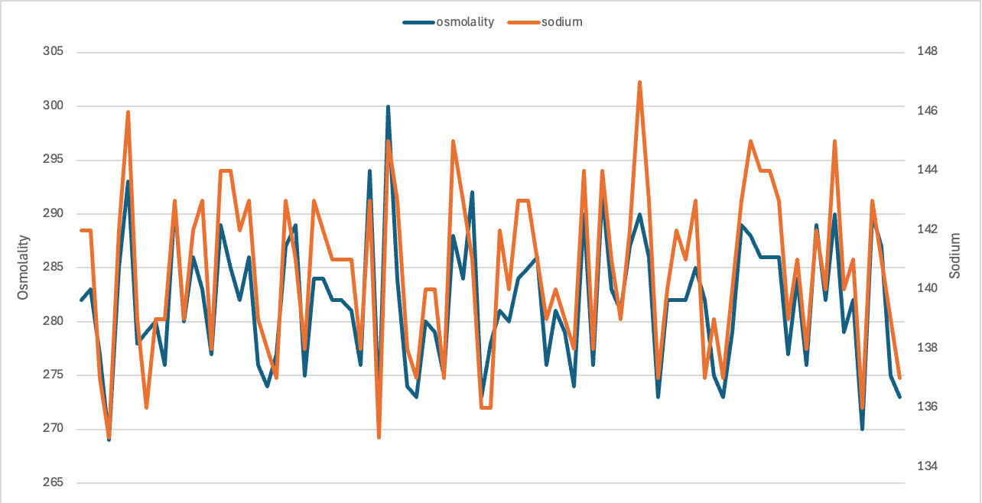
Always avoid Dual y axes
Why do this?
Same units but different magnitude
Different units
Problems:
Data to axis match is often not clear
Crossing lines and changes can be misleading
Changing scales may alter interpretation
Notes:
Start bar charts at zero, avoid dual y-axes and 3D, choose sensible binning/smoothing, and keep aspect ratios that don’t distort trends. Ex: QC run charts with consistent y-limits across instruments/lots.
akj

Slide 45
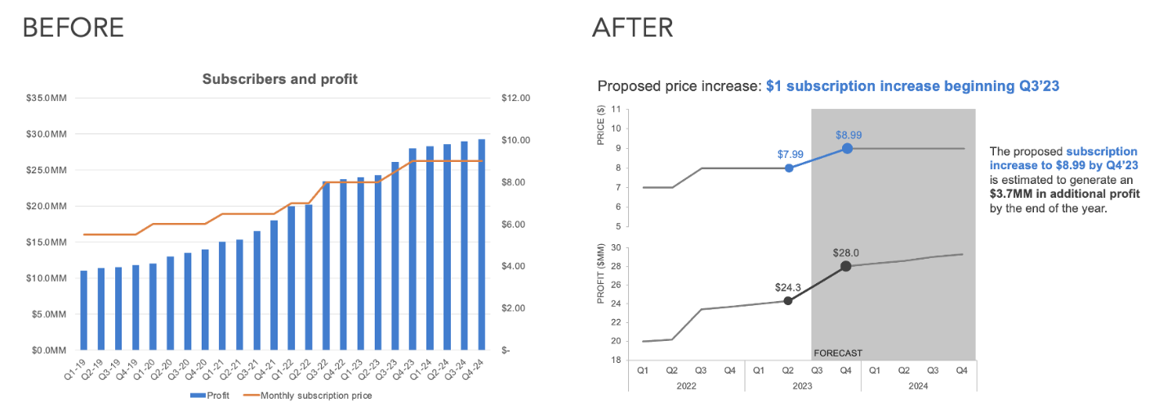
Try A better alternative
https://www.storytellingwithdata.com/blog/declutter-a-dual-y-axis-chart
Notes:
Other options are side-by-side, stacked with reference, and index plots

Slide 46
Normalize & provide reference
Show rates/percentages (with denominators) when group sizes differ
Add benchmarks (targets, medians) or difference-from-baseline views
Use per-unit scaling (e.g., per 1,000 tests) to put groups on comparable scales
Direct-label series/bars; minimize legend lookups
Put units in axis titles; add n and confidence intervals where relevant
Annotate key events (intervention, lot swap) right on the plot

Slide 47
Reduce clutter & clarify
Limit categories; group “other” or use small multiples instead of one crowded chart
Use light gridlines, short tick labels, and concise titles/subtitles, remove unnecessary titles and labels
Avoid rainbow palettes; use color purposefully to highlight comparisons
Apply transparency if data density is high

Slide 48
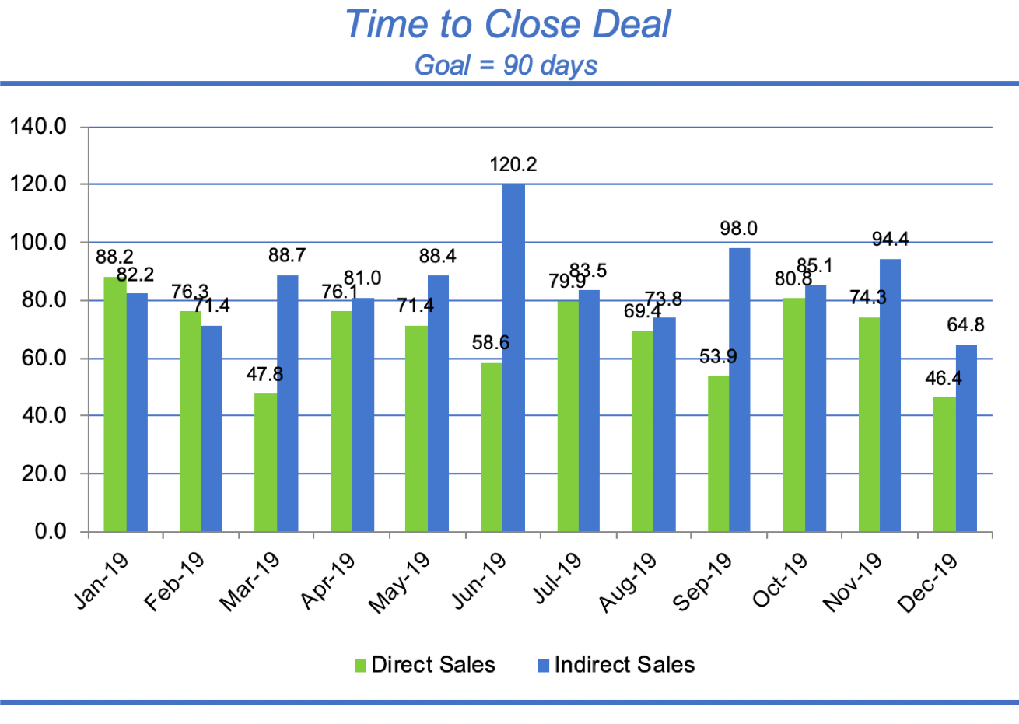
What is going wrong here?
Poll
doc
0.00817
bashful
happy
grumpy
sneezy
dopey
sleepy
0.00624
https://www.storytellingwithdata.com/blog/declutter-a-dual-y-axis-chart
Notes:
How many people got the same answers from both plot and table? Did you get answers from the plot vs the table?

Slide 49
Show more than averages
Replace mean ± SD bars with dot (+ CI), box/violin + jitter, or difference plots
Offer toggles (absolute vs %), tooltips for exact values, and “show table” for audit

Slide 50
How to make comparisons effortless?
Start with the right visualization and then refine it:
focus, sort, align, label directly, normalize fairly, and show uncertainty

Slide 51
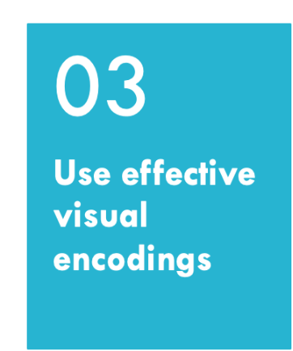
How can visual encoding help or harm visualization effectiveness?
What are visual elements?
01

Slide 52
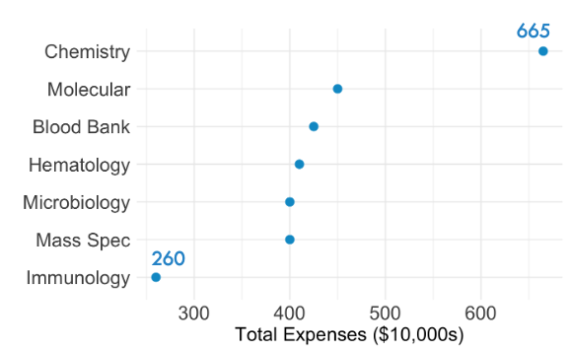
Which is better?
Poll
Notes:
How many people got the same answers from both plot and table? Did you get answers from the plot vs the table?

Slide 53
Visual channels can encode information
Use visual attributes to make aspects stand out or encode additional information making it easier to understand, compare, and retain
Commonly used elements: size, shape, color hue and intensity, length, and position
Most humans perceive these quantitatively to different degrees and many not well at all

Slide 54
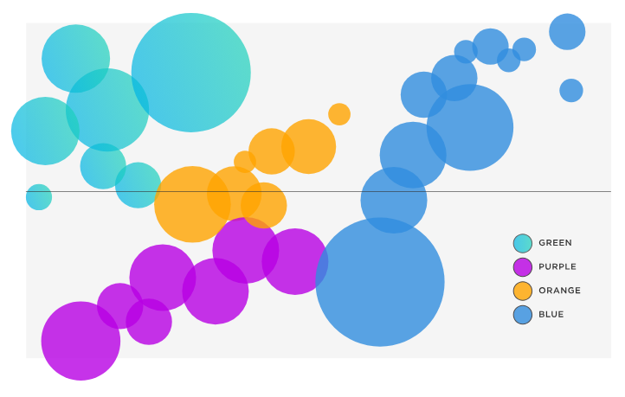
How well can we perceive relative area?
Poll
Compared to the circle on the left (A), how much bigger is the area of the circle on the right (B)?
B
A
Notes:
Answer is 12 i

Slide 55
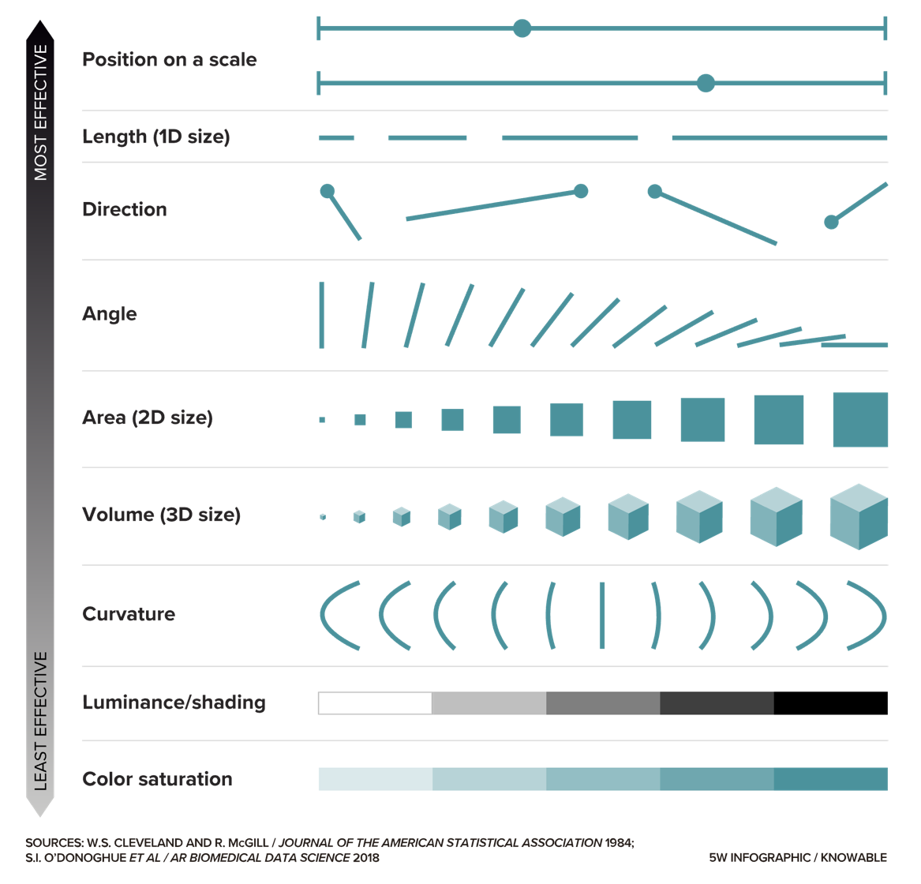
Effectiveness of Visual Elements
This is why data viz experts HATE pie charts, donut charts, and use of 3D!!
https://knowablemagazine.org/content/article/mind/2019/science-data-visualization
Notes:
Cleveland & McGill’s hierarchy of graphical perception

Slide 56
Effective use of visual channels
Match data type to channel and perceptual strength
Nominal (categories): color hue or shape
Ordinal (ordered): color lightness or position
Quantitative: position on a common axis (best), then length; avoid area/volume for precise comparisons
Combine channels wisely
Favor separable pairs (e.g., color + shape) over interfering ones (length + area)
Use redundant encoding to reinforce meaning and improve accessibility
Aim for simplicity and clarity
Use the minimal number of encodings necessary
Avoid visual clutter and 3D effects

Slide 57
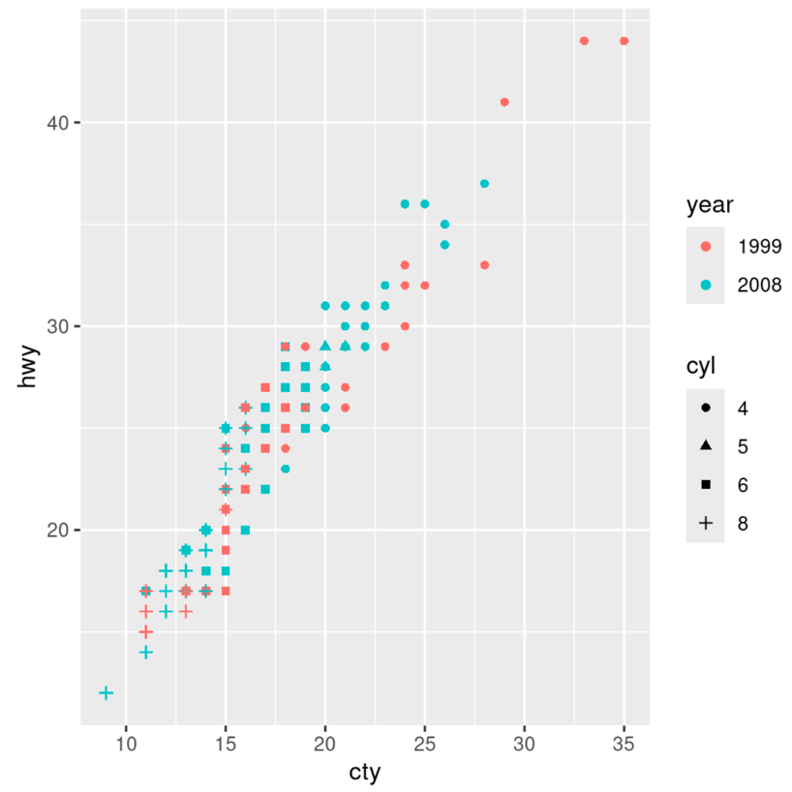
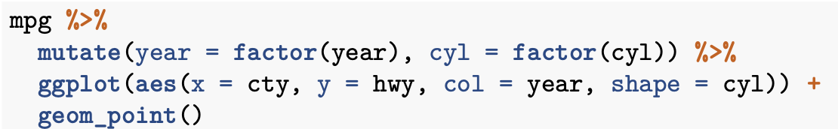
Example from MSACL DS101
Data variable
Columns to plot on x and y axes
Chart type
Visual encoding for color and shape

Slide 58

How to most effectively use color?
Improve accessibility
Fast and accurate interpretation
How to improve readability?
01

Slide 59


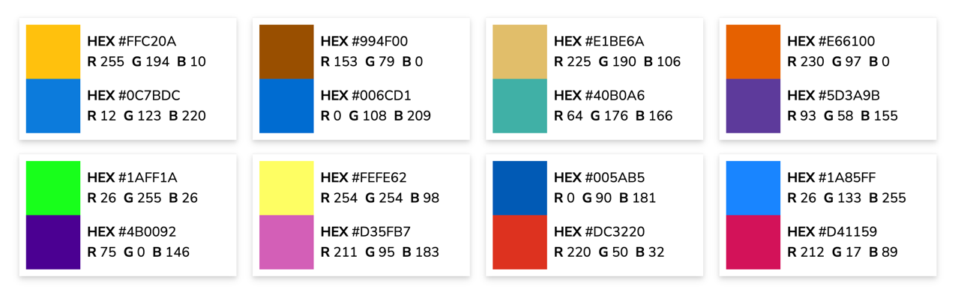
Colorblind Friendly Palettes
Colorblind Friendly Pairs
Notes:
Shannon

Slide 60

How well can we perceive color Intensity?
Poll
How much darker are the rectangles on the left than those on the right?
Notes:
The rectangles in this image are all the exact same shade of gray but look vastly different depending on the color that surrounds them. This phenomenon, known as simultaneous contrast, can cause readers to misinterpret the values represented by colors on a graphic.
From

Slide 61
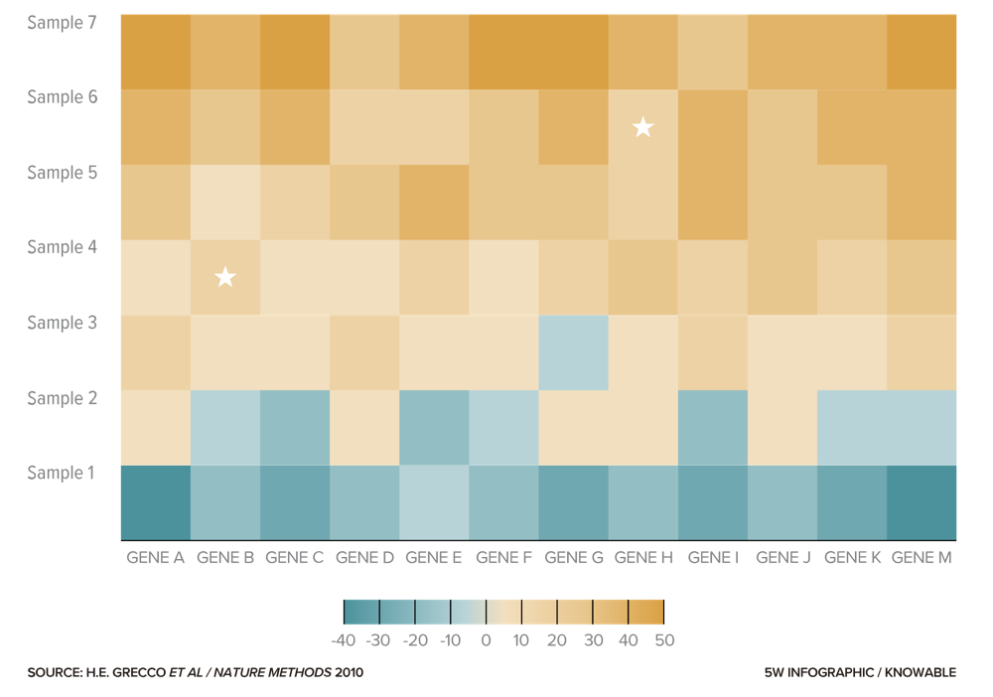
Simultaneous contrast can make heatmaps tricky to interpret
What are the values for
Sample 4, Gene B
Sample 6, Gene H
Notes:
Optical Illusions above – same star shades and greyscale shades
How much darker is the rectangle on the left vs on the right??? Neither – same color.

Slide 62
Best Use 0f color and intensity
Use Color Purposefully
Apply color to encode necessary aspects
Avoid using too many colors at once
Ensure Accessibility
Choose color palettes that remain clear for people with color vision deficiencies
Reinforce color encodings with labels, patterns, or shapes
Maintain Contrast and Consistency
Ensure sufficient contrast between colors and background
Use consistent color assignments across multiple charts to prevent confusion
Consider cultural or standard associations with color

Slide 63
Make it easier for everyone to read
Select appropriate font, size, and page flow
Use appropriate text size
Choose fonts with high legibility
Apply bold and CAPS to add emphasis
Layout visual flow as people normally take in information from a page
Add elements for alternative readers
Consider alternative text descriptions and formats for screen reader compatibility
Limit interactivity and customization or make accessible by keyboard and screen reader users

Slide 64
Data visualization best practices
Match visual to purpose & data type
01
Make comparisons effortless
02
Use effective visual encodings
03
Design for readability & accessibility
04

Slide 65
Let’s put it to practice
Exercise
Go back to the 2 graphs you made during our first exercise – how might you improve them?
Use your tool of choice and make a revised version of at least one of your graphs

Slide 66
Time’s up!!

Slide 67
What did you improve about your graph(S)?
Poll

Slide 68
Excel is not a great visualization tool
Very easy to make bad visualizations using defaults
A lot of ”chart junk”
Poor layouts and graphic options
Not very easy to make customizations

Slide 69
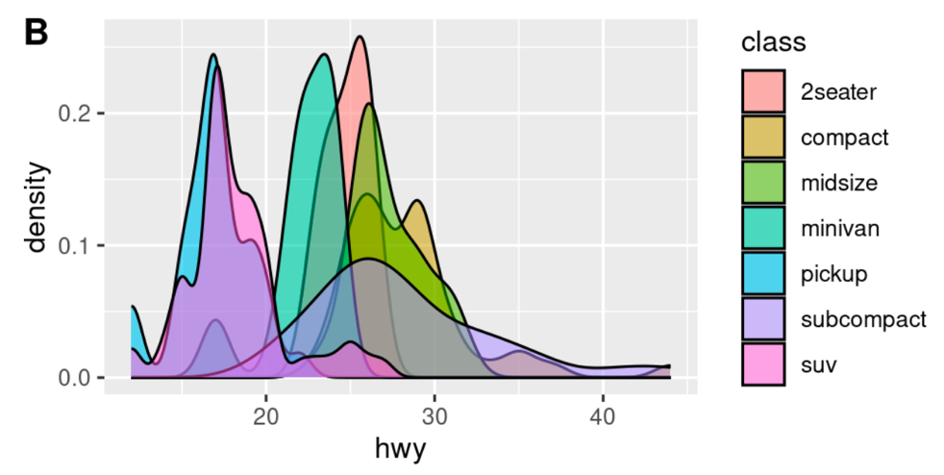
It’s just a tool – R can make bad plots too!
And it can do it faster and without getting tired!

Slide 70
summary
Creating effective visualizations requires knowledge of best practices
Default settings in visualization tools likely require modification
When communicating with visuals, keep these concepts in mind
Select the best visual for your purpose and data type(s)
Make comparisons and conclusions easy for the audience
Use visual encodings that are effective
Include elements that enhance readability and accessibility

Slide 71
Lesson Goals
Identify types of common data visualizations that are most appropriate given the types of data available and the goal of the analysis
Lesson Objectives
Describe at least 2 scenarios in which a plot is more effective than a table in demonstrating relationships between variables in a data set
For each possible combination of data types, identify a type of plot that will effectively illustrate the relationship between two variables
List 2 types of plots that can illustrate statistical uncertainty when comparing numeric values between groups.

